Slide 1
Template Guidance
Purpose
CE TARP is there to help and should not be a lengthy process to prepare for, particularly at early stages of a project or in innovation projects where there are regular design changes.
This template is for early submission to CE TARP before the architecture is all finalised and can be formally documented in an HLTD.
Guidance
Please update all green text in the template as this is required content. Once updated change colour as needed.
If available, then please update any of the amber text as this is additional useful content. If you don’t have this then it can be removed. Once updated change colour as needed.
Any red text is there for guidance only and can be removed.
It provides the minimum set of information required to enable early-stage project approvals and high-level design decision input.
It is intended for:
  Assistance with Technical / Architectural Decisions – providing options and getting input to help make the right architectural decisions early on.
  Innovation and DevOps teams who are rapidly iterating solution designs to test and learn / prove out potential approaches etc.
  Projects at an early stage, not yet ready for HLTD review and will then feed into the HLTD designs.
It does not remove the need for an HLTD for any solution but should be seen as a way to capture information to go into an HLTD.
Please submit your request for CE TARP using this form: CE TARP – Request form
If you require to engage Security consultancy and/or Service Design, use this form: Security and/or Service design Engagement - request form
This template is stored here: CE TARP – request template

Slide 2

CE TARP
Azure EMT DevTest Subscription Cleanups
21/10/2025
Vinoth H
Simplified Submission

Slide 3
Solution Overview / Business Requirements
Engagement checklist
CE TARP Ask
Create a new EMT DevTest subscription with proper controls:
Rename existing "EMT DevTest" → "EMT Sandbox“ and use it as experimental/sandbox environment
Remove orphaned and unused resources in the current EMT DevTest
Business Need
Establish proper security and compliance controls
Delete orphaned resources
Separate development resources from experimental/ sandbox work
Implement standardized subscription management practices (like other EMT subscriptions)
Objectives and Key Results (OKR’s)
Reduced operational costs through resource optimization
Enhanced security posture with proper access controls for the new EMT DevTest
Clear separation of development and sandbox subscriptions
Improved resource governance and accountability
Aligned to Group Cloud Principles or CE CCOE? | Yes
Aligned to Technology Strategy? | Yes
Aligned to the A.I. Tech Strategy? | NA
Do you have an approval or engagement with Centrica (group) EARB? | NA
Do you have an approval or engagement with CE ARB? | Yes
Do you have an approval from ISRB or engagement with security consultant engagement? | No
Was the design reviewed by Centrica network architecture or CE network team? | Yes
Is the submission for existing service or do you have new service design request raised? (if existing service, what is the name) | NA
Do you have an approval or engagement with Centrica procurement or CE PMO? | NA
Go Live Date
Service Business Criticality | Non-Critical

Slide 4
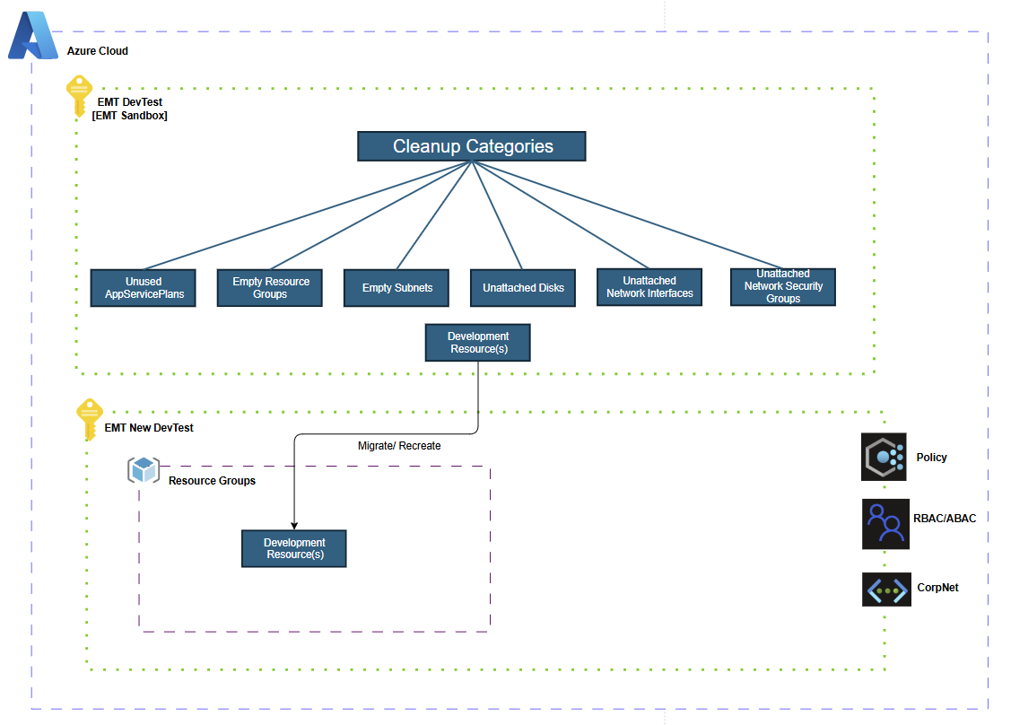
Architecture Overview
2 folds,
Cleanup Process
Resources categorized for deletion using Resource Graph Explorer queries
Resource Graph Queries (link) for the detailed resources list per category
Follow Cleanup Document (link) for pre-deletion steps to be followed
  Perform continual clean ups of the resources in the old EMT DevTest subscription
Migrations Steps
Dev resources to be recreated in the new EMT DevTest subscription (which has proper controls/ governance)
Validate the functionality, connectivity in the new subscription
Delete resources in the old EMT DevTest (EMT Sandbox) only after successful migration verifications
Notes:
Detail with diagrams the use of;
Encryption, Key Management, Authentication & Authorisation, Privilege Access Management, Identity Management, Web Application Firewall, Network Firewall (NGFW), Network Segmentation (VPC/NSG), Web Proxy, Audit Logging, Time Synchronisation, Security Incident, Event Monitoring, Malware Protection, Application Security Testing, System Hardening baseline verification, Vulnerability Scanning, Security Patching, Information Asset Register, Backup and Recovery, Secure Coding Practices.
Considerations for SAP Projects:
What are the impacted SAP backend systems?
What are the impacted front-end systems?
Does part of the project require code changes? if so, in what systems?
What other configuration changes are being made? And on what systems?
Are there any new interfaces being deployed by the project?
Do the changes include schema changes? If so, what tables are impacted?
Considerations for Power Platform: and/or RPA.
What connectors are being used? And will there be any external integrations?
Which Environment is being used?
Are Portals (public access) being used?
Is code being used in the flow / app?
Who will be the end consumers of the flow / app?
How will access control work with this flow/app and it's data?
If RPA is being used where will the agent be deployed? What controls surround the agent host? Is all software on the host under a patch management policy?
Is Sensitive data being handled? If so how is this being processed / stored?
How frequently will the Application or Flow change? What sort of change can be expected over time?
Is there any applicable regulatory compliance surrounding the flow / app or data?
What is the exact scope of the requested approval? (e.g scope of "processing actions" and "data types")

Slide 5
Network and Security Requirements
Location
Platform(s) | Azure
Account/ Subscription | EMT DevTest (New subscription) | Proper controls to be in place
Network Controls
Any Public Ingress | Yes/No | Adhere to EMT Subscriptions EMT Preproduction: 9fab4099-0a76-4178-80d4-3011597c9154 EMT Production: 71f83568-809f-4b21-96b5-90502812d9e3
Connected to Corp Network | Yes | Adhere to EMT Subscriptions EMT Preproduction: 9fab4099-0a76-4178-80d4-3011597c9154 EMT Production: 71f83568-809f-4b21-96b5-90502812d9e3
Access to service via | <SSL / SSH / RDP / other>
Access Controls
Authentication | AAD | Adhere to EMT Subscriptions EMT Preproduction: 9fab4099-0a76-4178-80d4-3011597c9154 EMT Production: 71f83568-809f-4b21-96b5-90502812d9e3
Authorization | RBAC> | Adhere to EMT Subscriptions EMT Preproduction: 9fab4099-0a76-4178-80d4-3011597c9154 EMT Production: 71f83568-809f-4b21-96b5-90502812d9e3
Data Classification
Data Classification | <Highly Confidential / Confidential / Internal / Public / Production data>
Regulatory Coverage | PCI-DSS | No
 | FCA | No
 | GDPR | No
 | Other | No

Slide 6
Cloud Costs
All development workloads will be moved into the new EMT DevTest subscription
Orphaned resources will be deleted. Cost to be quantified (based on the resources to be deleted by Operations team)
Document to be referred for identifying the orphaned resources,

Slide 7
Engagement details
 | Request (RITM) | Consultant/s | State | Date
Enterprise Architecture
CE ARB
Security team | RITM0925365 |  | Pending For Review | 22/10/2025
Network team
Service design and introduction
Procurement
The information helps the approval process ensuring the dependent approvals are either completed or in progress.

Slide 8
Note. Approval of a simplified TDA submission does not replace the need for an HLTD, but serves to capture information at an early stage to be used in the HLTD later.

Slide 9
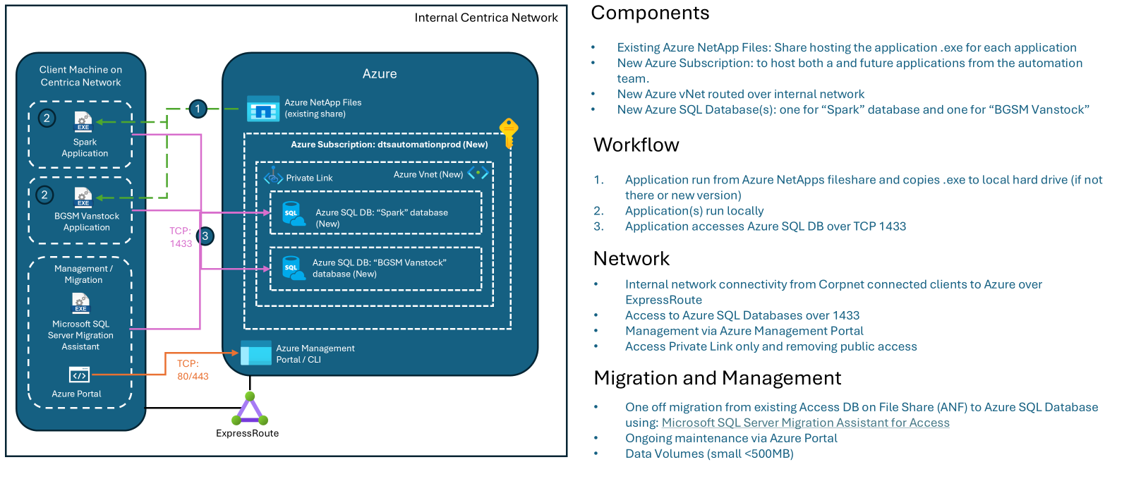
Architecture Overview - example
Notes:
Detail with diagrams the use of;
Encryption, Key Management, Authentication & Authorisation, Privilege Access Management, Identity Management, Web Application Firewall, Network Firewall (NGFW), Network Segmentation (VPC/NSG), Web Proxy, Audit Logging, Time Synchronisation, Security Incident, Event Monitoring, Malware Protection, Application Security Testing, System Hardening baseline verification, Vulnerability Scanning, Security Patching, Information Asset Register, Backup and Recovery, Secure Coding Practices.
Considerations for SAP Projects:
What are the impacted SAP backend systems?
What are the impacted front-end systems?
Does part of the project require code changes? if so, in what systems?
What other configuration changes are being made? And on what systems?
Are there any new interfaces being deployed by the project?
Do the changes include schema changes? If so, what tables are impacted?
Considerations for Power Platform: and/or RPA.
What connectors are being used? And will there be any external integrations?
Which Environment is being used?
Are Portals (public access) being used?
Is code being used in the flow / app?
Who will be the end consumers of the flow / app?
How will access control work with this flow/app and it's data?
If RPA is being used where will the agent be deployed? What controls surround the agent host? Is all software on the host under a patch management policy?
Is Sensitive data being handled? If so how is this being processed / stored?
How frequently will the Application or Flow change? What sort of change can be expected over time?
Is there any applicable regulatory compliance surrounding the flow / app or data?
What is the exact scope of the requested approval? (e.g scope of "processing actions" and "data types")

